Slide 1
Clustering Neighborhoods in Order to Analyze Policy Needs
Alex Semyonov
Jacob Dunham
Orlando Gonzalez

Slide 2
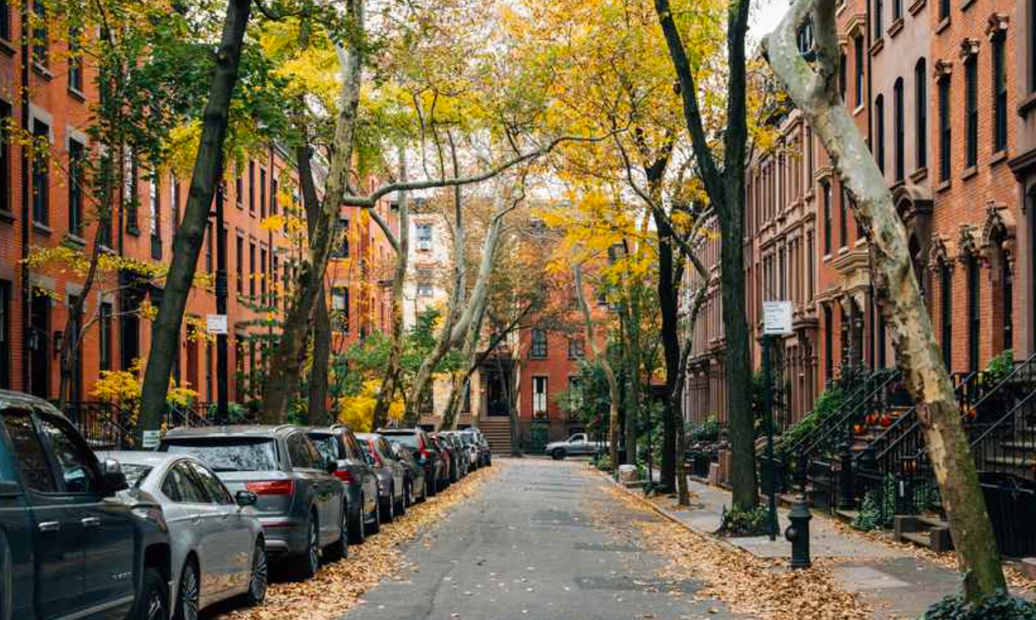
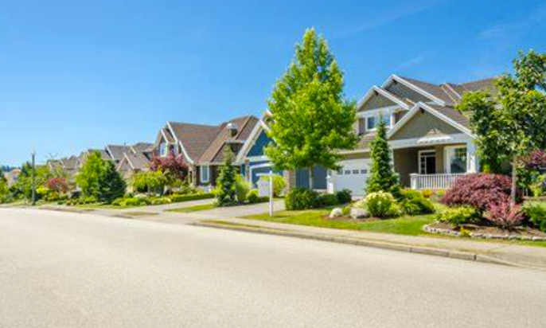
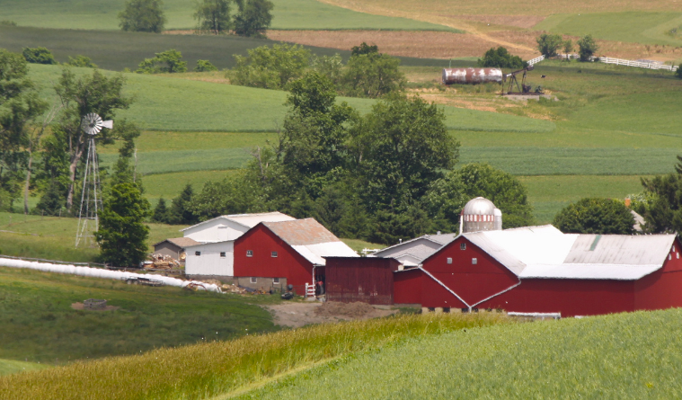
Problem and Motivation Overview
Neighborhood Characteristics:
Average Rent
Total Jobs
Average Annual Wage
Percent of Renters Who Spend More than 30% on Rent
Total Housing Units
Park Acres per 1000 Residents
This project is driven by the notion that all neighborhoods should have unifying living standards. These standards should maintain a minimum quality of life for residents regardless of socioeconomic barriers. We developed a data based tool that clusters similar neighborhoods based on characteristics that can be standardized by policy makers.
This tool can help policy makers visualize neighborhood characteristic correlations and trends as clusters in a way that can lead to practical policies to improve and maintain neighborhoods’ quality of life (i.e. push neighborhood clusters towards desirable clusters).

Slide 3
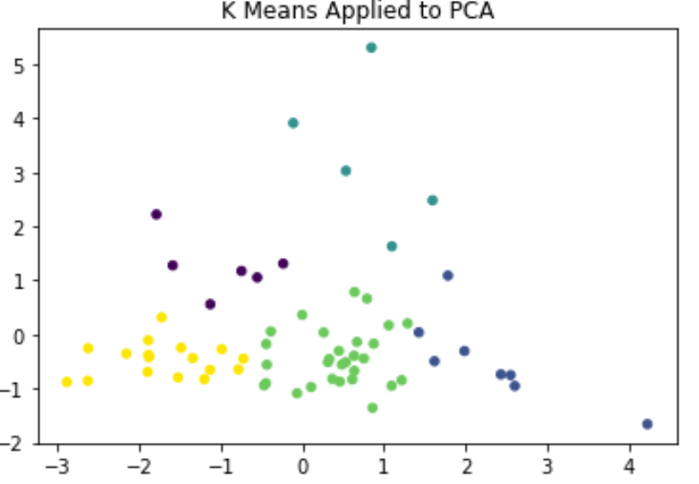
Collected Data and how it is used
Example Clusterings represented in 2D:
Multiple neighborhood datasets are collected and used to create a characteristic profile called a feature vector. We can plot these feature vectors as a single (n-dimensional) point that represents that neighborhood.
Example neighborhood feature vector:
Congress Park : [ $2564, 3154, $80,724.01, 40.42%, 6250, 4.94 ]
Where each feature respectively represents: Average Rent, Total Jobs, Average Annual Wage, Percent of Renters Who Spend More than 30% on Rent, Total Housing Units, and Park Acres per 1000 Residents.
Sample neighborhood
We will use neighborhood traits to find neighborhood clusterings in n-dimensional space which can help policy makers better understand neighborhoods and how to improve them.
Neighborhood data is collected from public research datasets.

Slide 4
Clustering Method
The technique our group used in actually clustering the neighborhood data is called k means clustering. We implemented a constrained k means algorithm so that we force the neighborhoods into evenly distributed clusters. This is advantageous in eliminating data outliers so that our neighborhood groups are averaged clusters that can lead to insights for the development of practical policies.
What traits clustered these neighborhoods together?
Which clusters maintain a low quality life?
How can we push these clusters towards desirable clusters through policy?
Policies that maintain a living standard for all neighborhoods in Colorado.

Slide 5
Initial Stages
Prior to delving headfirst into this analysis, we wanted to make sure that our data can be clustered relatively well.
Oftentimes, data does not cluster well (or requires a more sophisticated clustering technique). In order to develop a baseline for our neighborhood clustering, we ran a standard K-means algorithm on our data and investigated the results.

Slide 6
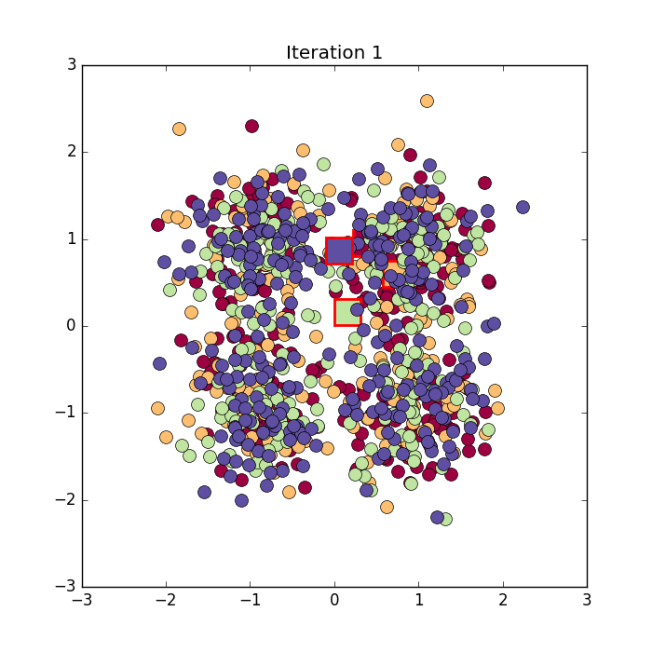
Visualization of K Means Clustering Algorithm
This is a visualization for the K-Means Clustering algorithm.
We start with random centers (the red boxes).
We cluster our data according to these cluster centers (the colors denote the different clusters).
We move our cluster centers to the center of each cluster.
We repeat this until the cluster centers stop moving.

Slide 7
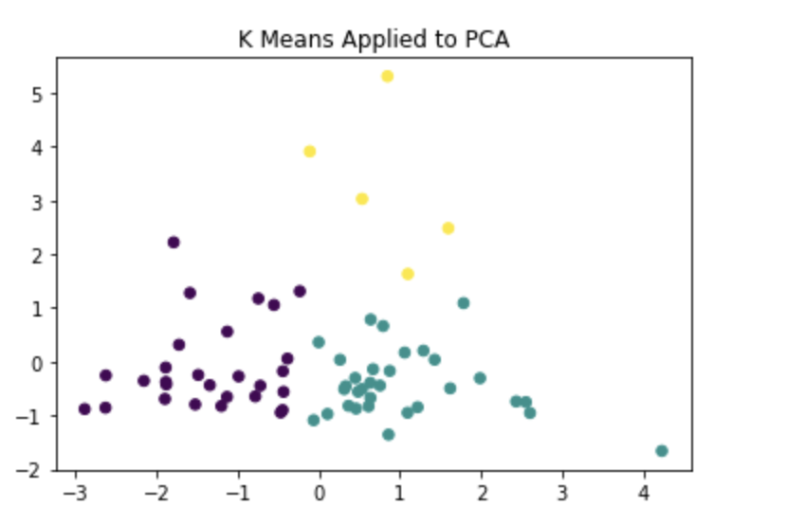
Visualizing our Clusters
Recall that our original points lie in 6D space.
We use Principal Component Analysis (PCA) to project our initial data into two dimensional space. While this does yield some data loss, it makes it possible to actually visualize our clusterings.
PCA tries to reduce the dimension of our data while still preserving as much of the information as possible.
There is always inherent information loss when reducing the dimension of our data.
This is a visual representation of our initial K Means Clustering on the principal components of each point

Slide 8
Constrained K-Means Problem
Upon establishing that the K-Means algorithm reasonably clustered this data, we wanted to ask an additional question: Instead of just clustering our data, what would happen if we force each cluster to have the same number of neighborhoods?
This helps deal with “outlier” clusters
This is also mathematically a bit more interesting.
In order to solve this problem we needed to develop an algorithm.
This algorithm tries to find the best cluster centers by first “guessing” what these centers could be and then iteratively improving this initial guess. This is essentially what the standard K-means algorithm does, but we additionally force each cluster to have the same number of neighborhoods.

Slide 9
Algorithm to Solve Constrained K Means
Our algorithm mirrors the standard K-Means algorithm and can be broken down into two steps:
Given cluster centers, we solve the resulting Least Squares Assignment problem (which is a typical supply and demand linear program) (Assignment Step)
Move each cluster center to the center of each cluster (Update Step)
The algorithm alternates between these two steps until our cluster centers stop moving and starts with initial cluster centers.

Slide 10
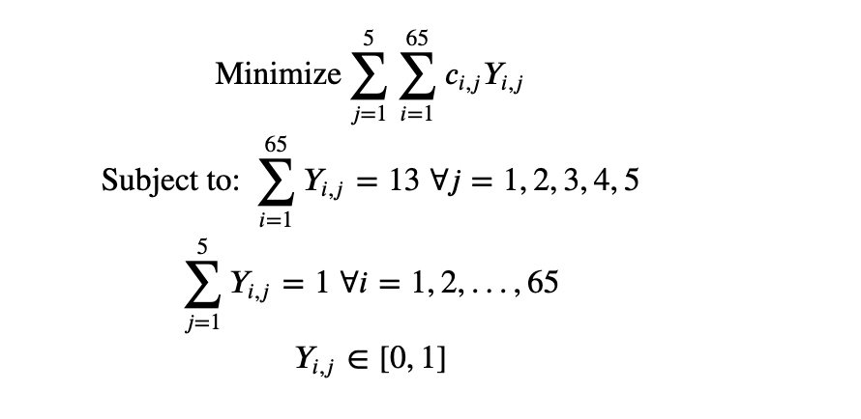
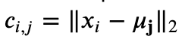
Linear Program to Determine Assignment
At each step of our algorithm, we solve an LP, the formulation of this LP is given below:
Note that, if we don’t have the
cluster centers beforehand this is a nonlinear program.

Slide 11
Results of the Constrained K Means Problem
Our algorithm was able to successfully group our neighborhoods and also find our cluster centers. I’ve provided our final clustering below:
Cluster 1: 'Belcaro', 'Congress Park', 'Cory - Merrill', 'Country Club', 'Highland', 'Hilltop', 'Lowry Field', 'Platt Park', 'Rosedale', 'Washington Park', 'Washington Park West', 'Wellshire Denver', 'West Highland'
Cluster 2: 'Capitol Hill', 'Cherry Creek', 'Five Points', 'Green Valley Ranch Denver', 'Hale', 'Hampden', 'Hampden South', 'Montbello', 'Speer', 'Stapleton Denver', 'Virginia Village', 'Washington Virginia Vale', 'Windsor'
Cluster 3: 'Barnum West', 'Bear Valley', 'Berkeley', 'Cheesman Park', 'East Colfax', 'Fort Logan', 'Indian Creek', 'Montclair', 'Overland', 'Skyland', 'Sloan Lake', 'Southmoor Park', 'Sunnyside'
Cluster 4: 'Athmar Park', 'Barnum', 'Chaffee Park', 'Clayton', 'College View - South Platte', 'Goldsmith', 'Harvey Park', 'Harvey Park South', 'Mar Lee', 'Regis', 'Ruby Hill', 'Valverde', 'Westwood'
Cluster 5: 'Baker', 'City Park', 'City Park West', 'Cole', 'Denver International Airport', 'Elyria Swansea', 'Globeville', 'Jefferson Park', 'Lincoln Park', 'Sun Valley', 'University', 'Villa Park', 'West Colfax'

Slide 12
Final Cluster Centers
Format: Average Monthly Rent, Total Jobs, Average Annual Wage, Renters who spend more than 30% on rent, Total Housing Units, Park Acres per 1000 residents.
Cluster 1: $2248.31, 3021.46, $114832.13, 0.38, 3346.08, 9.56
Cluster 2: $1969.85, 11602.15, $65612.017, 0.47, 8258.54, 89.98
Cluster 3: $2043.46, 1576.54, $66452.37, 0.40, 3380.08, 14.67
Cluster 4: $1610.69, 2303.31, $46866.01, 0.55, 2926.38, 11.89
Cluster 5: $2207.77, 7142.08, $50350.23, 0.49, 2341.46, 1009.05

Slide 13
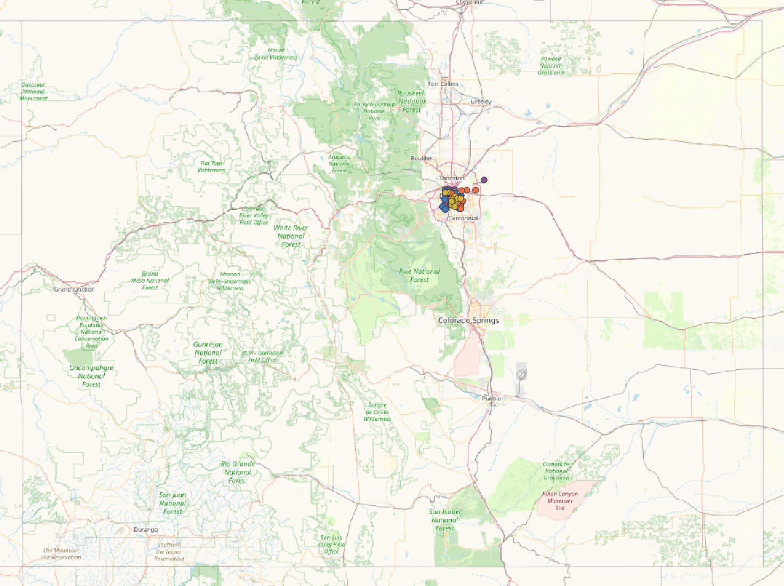
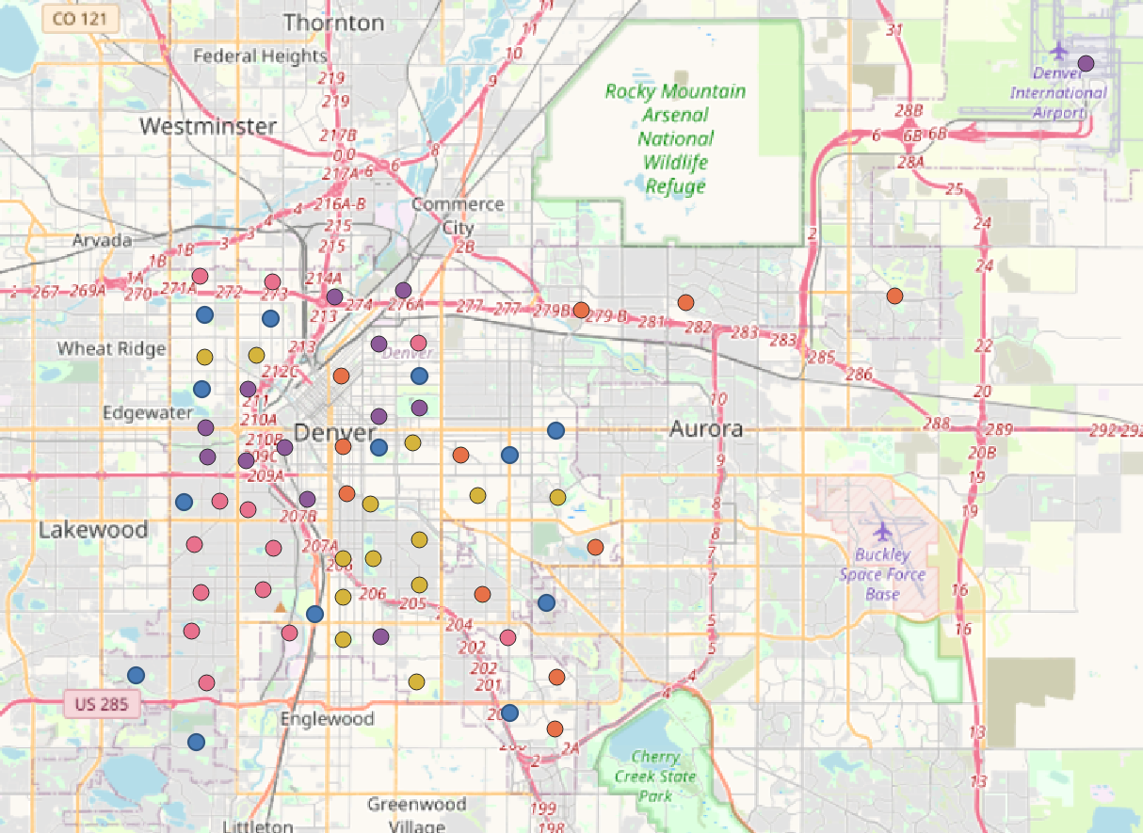
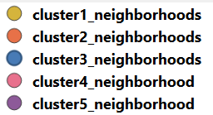
Final Clusters Visualized in GIS
Mapping the processed neighborhoods in GIS will let us see how clustered neighborhoods relate to one another geographically. This could lead to insights regarding policies focused on geographical regions.

Slide 14
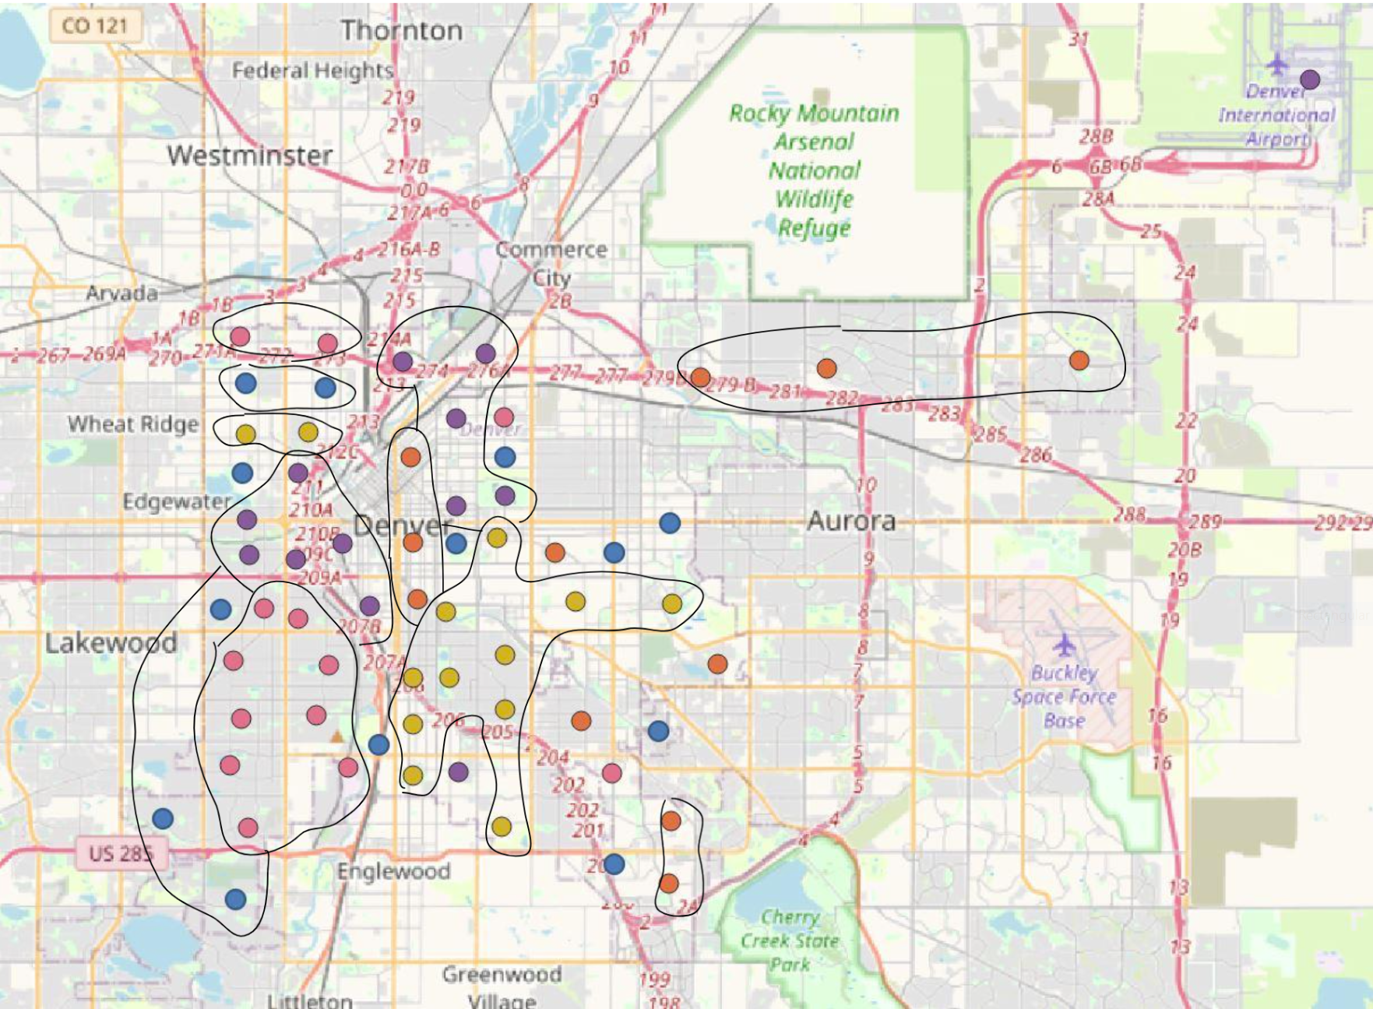
Key:
Final Clusters Visualized in GIS
From the results of our GIS plots we find that there is a geographic significance in the clustering of neighborhoods. Neighborhoods in the same K means clusters tend to be geographically clustered to one another. Note: There are also “outlier” geographic clusters of neighborhoods that do not match our K means clustering results.

Slide 15
Advantages of Clustering From a Policy Perspective
Neighborhoods that are clustered together may have similar features, giving rise to policy ideas that can help many neighborhoods at once.
It can be easier to analyze clusters of neighborhoods rather than looking at each neighborhood individually.
Any number of desired parameters can be used in the clustering algorithm, allowing analysis of multiple variables at the same time.
Clustering can be used both proactively and reactively.
Policies can be created based on discrepancies in parameters between clusters.
Policies already in place can be more optimally targeted based on discrepancies in parameters between clusters.

Slide 16
Disadvantages of Clustering From a Policy Perspective
In order to have meaningful clusters, data points for each parameter of interest must be available.
Some neighborhoods can have outlier values for certain parameters, giving clusters with skewed centers. We see this with cluster 5 and park acres per 1000 residents in our example. The center for cluster 5 has 1009.5 park acres per 1000 residents, while the next closest value is cluster 2 with 89.98 park acres per 1000 residents. This is primarily caused by two outlier neighborhoods, Denver International Airport and Stapleton(now Central Park), which have 12,877.54 and 1,064.17 park acres per 1000 residents respectively.
Skewed cluster centers can misrepresent inequities between groups of neighborhoods, and give unrealistic expectations for closing the gap between those discrepancies.

Slide 17
General Policy Suggestions
Ideally, the clustering algorithm can be used as a tool to identify good potential candidates for the optimal allocation of resources. Clustering has been used to suggest specific policies, but we also suggest implementing a standard for new resource allocation which includes using a clustering algorithm when determining where said resources are needed.
According to Paul Kresser, the CIO of the city and county of Denver, cloud technologies for data storage and sharing began to be adopted starting in 2018.
Kresser was quoted in OCt. 2022 saying “We now have a much better grasp on our data, and we’re in the process of selecting and soon to be implementing the data catalog solution that we think is going to enable self-service analytics across the city.”

Slide 18
General Policy Suggestions cont.
Kresser is also quoted saying “Looking five years into the future, I am intrigued by the application of AI and machine learning technologies to help make real-time, data-driven decisions.”
Based off of this information, we believe the city and county of Denver has the data and the desire to implement machine learning algorithms for policy decisions.
Thus, we believe our suggestion of implementing a standard for resource allocation which includes a clustering algorithm is in line with the goals of Denver.

Slide 19
Policy Suggestions Using Our Example
We now turn to more targeted policy suggestions using the data and clustering from our example. We specifically look at cluster 4, which has the lowest average rent, lowest average annual wage, and highest percentage of renters who spend 30% or more on their income on rent.
Based on this information, we first suggest Denver look into a rental assistance program starting with neighborhoods in cluster 4. If Denver were to consider assisting with a percentage of rent, it would help those most in need and potentially cost less than a flat amount of rental assistance.
Secondly, we suggest Denver consider the addition of new ‘public no cost grocery stores’, first looking into neighborhoods in cluster 4. According to Denver Food Rescue, there is currenly only one such store in cluster 4, located in Ruby Hill.
A closer look at these neighborhoods could help determine how many such stores are needed and where they should be placed, but our clustering algorithm suggests which locations should be looked at more closely.

Slide 20
Improvements to the Algorithm
The developed tool is limited by the data we were able to find online for neighborhoods in Colorado. The feature vectors of each neighborhood can be augmented with more data (that is available or collected) such that it can lead to focused policy development. The aim of the tool is to maintain a living standard for all neighborhoods in Colorado and we acknowledge that the tool is as impactful as the quality of data it is fed. We also acknowledge that a tool that classifies neighborhoods can be used nefariously by policymakers. We hope that a tool like this would only ever be used for good with the best intentions to improve the quality of life of all Colorado residents.

Slide 21
References
Our neighborhood data was collected from: https://denvermetrodata.org/neighborhoods
And our rent data was collected from: https://rentcafe.com/average-rent-market-trends/us/co/denver/
The paper below provides a great overview of clustering:
https://www.microsoft.com/en-us/research/wp-content/uploads/2016/02/tr-2000-65.pdf
Denver Food Rescue:
https://denverfoodrescue.org/public-food-programs/
An interview with Denver city and county CIO Paul Kresser:
https://www.snowflake.com/blog/how-city-county-denver-uses-data-change/

